Slide 1
Team A: Standards and Regulations
John Harrington, Ryan Lee, Alex Pletta,
Russell Wong, Ben Younes
Notes:
John (1-7)

Slide 2






The CraterGrader Team
John Harrington
Ryan Lee
Alex Pletta
Russell Wong
Ben Younes
Dr. William “Red” Whittaker

Slide 3
Preview
S&R #1: MIL-STD-883-1 - Environmental Test Methods for Microcircuits Part 1: (Selected Parts)
S&R #2: ISO 22646:2005 - Space data and information transfer systems (Space packet protocol)
Notes:
Russell

Slide 4
S&R #1: MIL-STD-883-1 - Environmental Test Methods for Microcircuits Part 1 (Selected Parts)

Slide 5
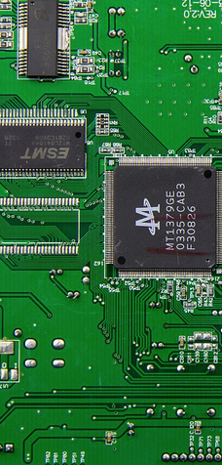
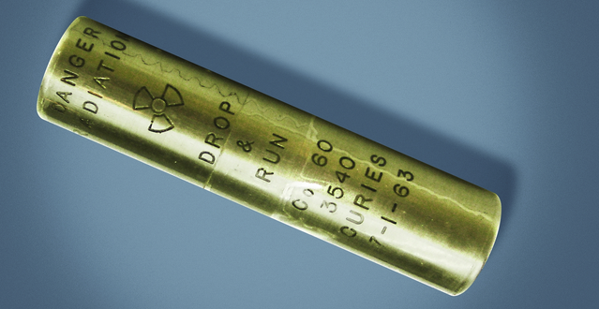
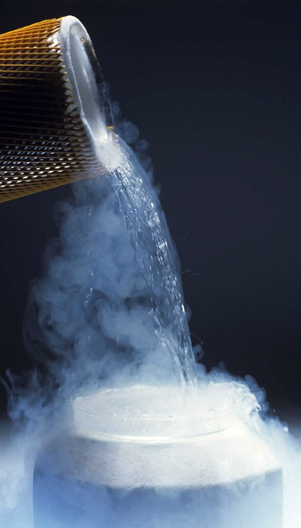
Standard and Regulation Overview
MIL-STD-883-1 - Uniform Test Methods for Environmental Testing of Microelectronics
METHOD 1019.9: IONIZING RADIATION (TOTAL DOSE) TEST PROCEDURE
Defines the requirements for testing packaged semiconductor integrated circuits for ionizing radiation effects from a cobalt-60 (60Co) gamma ray source.
METHOD 1020.1: DOSE RATE INDUCED LATCHUP TEST PROCEDURE
Defines requirements for latchup testing of microcircuits to identify susceptibility to dose rate induced latchup
Latchup = circuit region turned on by pulse of ionizing radiation and stays on until reset, disrupting normal circuit operation.
METHOD 1021.3: DOSE RATE UPSET TESTING OF DIGITAL MICROCIRCUITS
Defines requirements for testing responses of packaged integrated circuits to pulsed ionizing radiation (x-ray or linear accelerator sourced).
Notes:
What is it about?

Slide 6
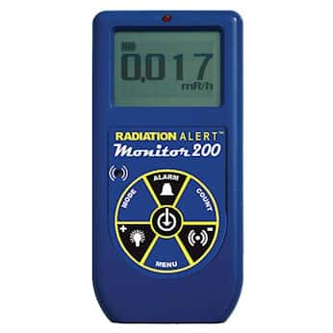
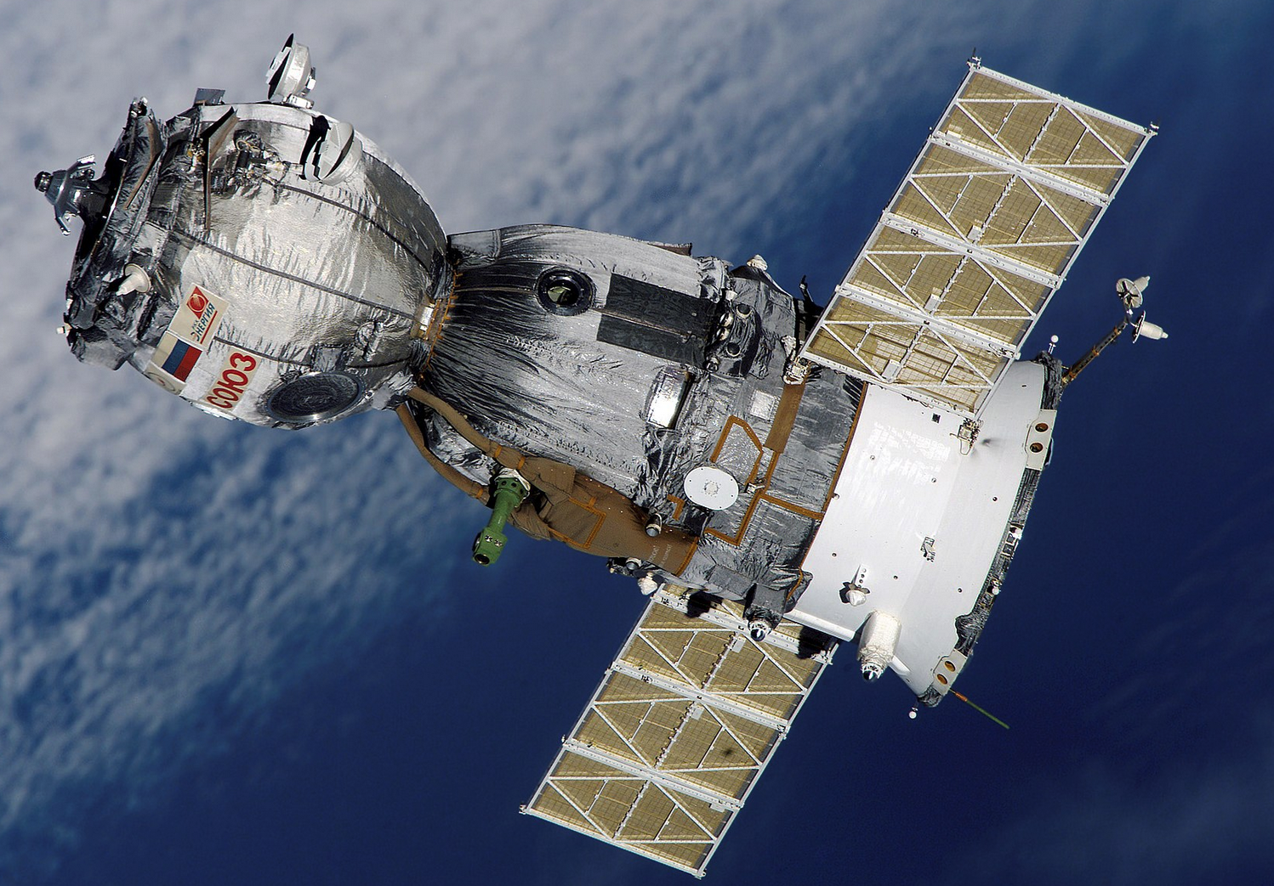
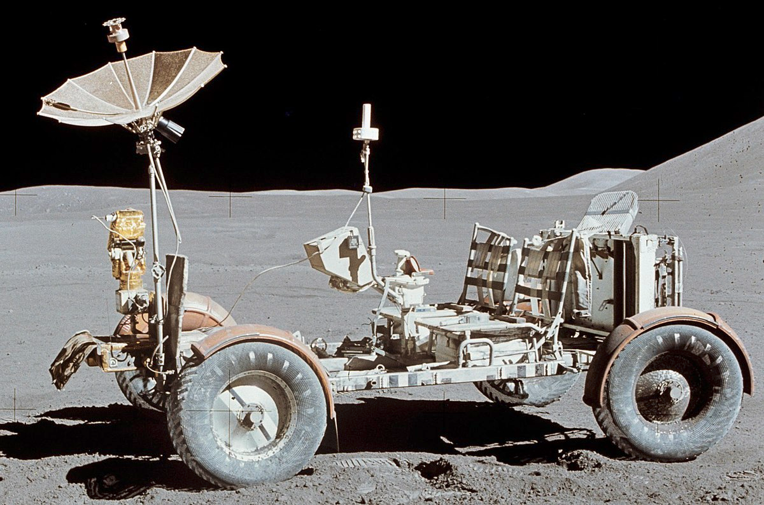
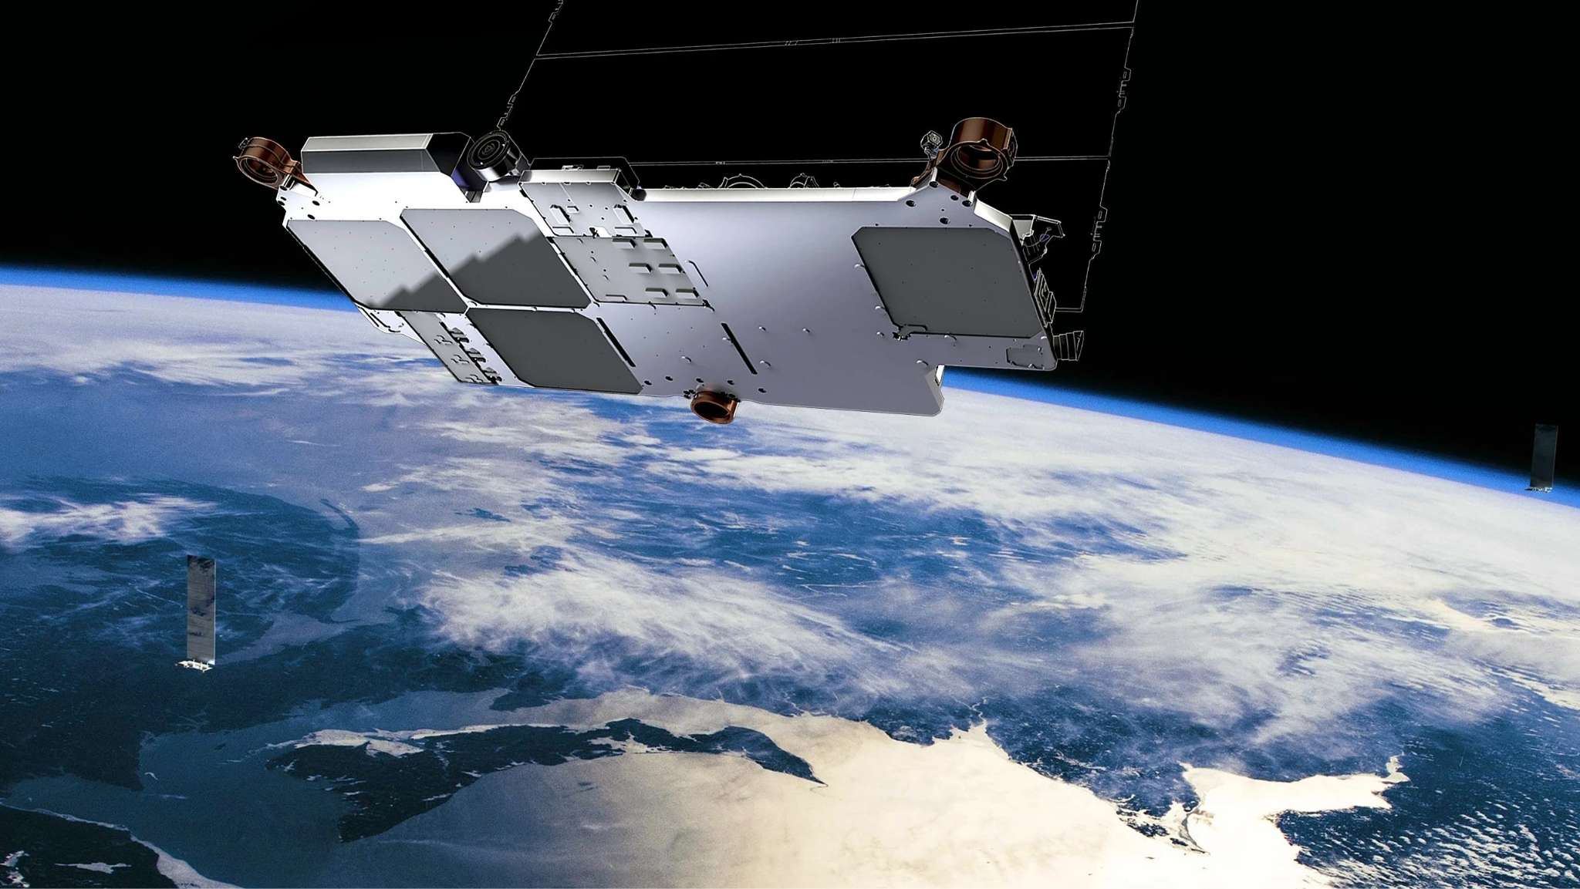
Product/Market Segment
Adds value to product operating in high-radiation environments (performance, lifespan, robustness, etc.)
Key Markets: Space, Military, Energy
Notes:
To which products/markets does it apply?
Anything going to space!

Slide 7
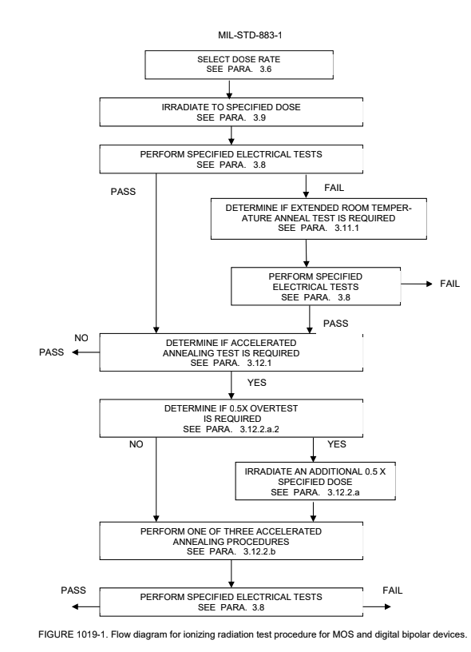
Main Prescriptions: Ionizing Radiation (Total Dose)
Basic Test Processes:
Irradiate circuit
Perform functional tests (component-specific)
Anneal if required (time & temperature dependent)
Perform more functional tests
Considerations:
Post-irradiation annealing (Room temp or accelerated)
Time Dependent Effects
Enhanced Low Dose Rate Sensitivity
Bipolar transistors or linear circuit functions
Notes:
What are its main prescriptions?

Slide 8
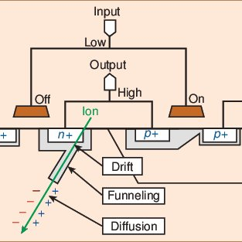
Main Prescriptions: Dose Rate Induced Latchups
Test procedure:
Prepare circuit
Irradiate circuit (Flash x-ray or Electron Accelerator)
Measure and wait recovery time of circuit
Perform functional tests to determine if latchup occurred
Considerations:
Operating Temperature
Radiation pulse width (typically 20 - 100 ns)
Current draw during testing (don’t affect results!)
Deliverables:
Latchup window
Recovery period
Holding current characterization
Latchup (link)
Notes:
What are its main prescriptions?

Slide 9

Main Prescriptions: Dose Rate Induced Upsets
Dose Rate Induced Upsets:
Transient changes of logic levels above acceptable margins
Unrecovered state changes
Dynamic changes in state output during irradiation
Testing Considerations:
Accounting for all variations of circuit states
4-bit device has 16 unique states to test
Hard to scale, so important to rationalize choices!
Upset threshold based on allowable voltage swing based on device logic swing margins and circuit response time.
Notes:
What are its main prescriptions?

Slide 10
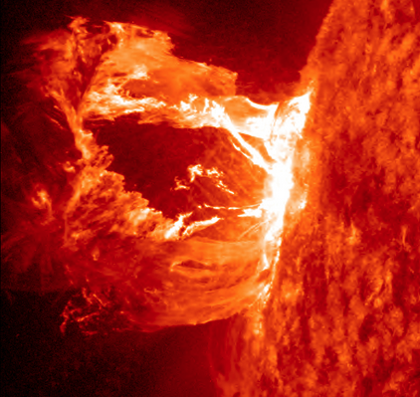
Main Prescriptions: Considerations Reviewed
Ionizing Dose testing needs to consider…
Time Dependent Effects (TDE)
Silicon Burn In
Transients
Shielding and Secondaries
If system state affects dose
On/Off
Grounded / Open Circuit
Temperature effects
Operational & Annealing
Notes:
What are its main prescriptions?

Slide 11
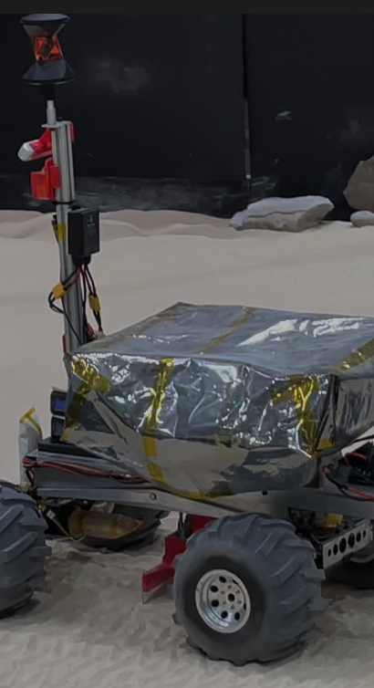
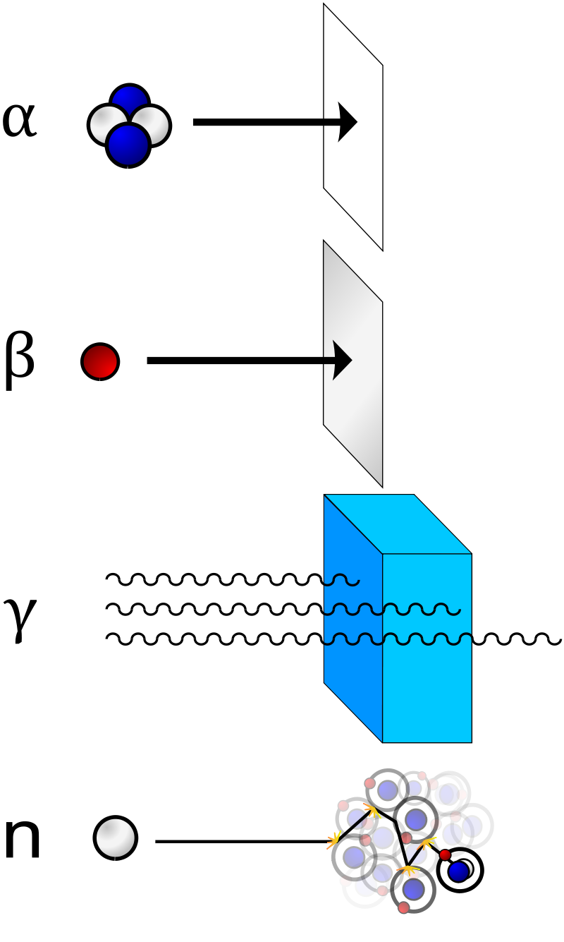
CraterGrader Application
In flight application, CraterGrader would be exposed to:
Cosmic Background
Extremely High Energy
Single particles can have energy of a baseball thrown at 60 mph
Solar Events
High Flux, Unpredictable
Gamma rays, neutrons are worst
→ Important to design properly to mitigate risks
Notes:
How does it apply to the team's project?

Slide 12
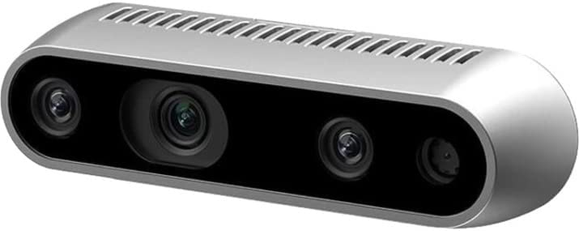
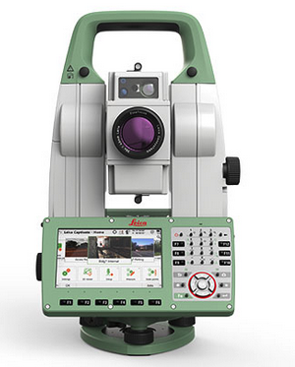
CraterGrader Application
Critical to understand, characterize and protect critical PCB’s or devices relating to:
Sensing
Compute
Clocks
Radios
Data Storage
→ Prefer components with verified supplier testing and/or test directly prior to use
Notes:
How does it apply to the team's project?

Slide 13
S&R #2: ISO 22646:2005 - Space data and information transfer systems (Space packet protocol)

Slide 14
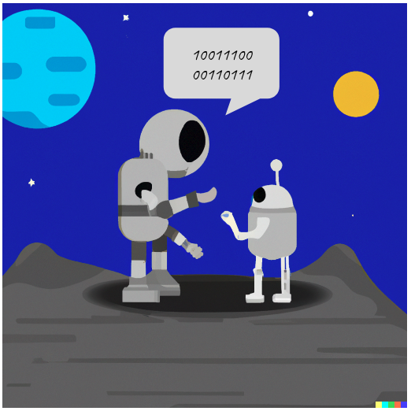
Standard and Regulation Overview
Space packet protocol defines standards and procedures for transferring space application data over a network
Proposes framework; not implementation details (methods, technologies, products, activities, etc.)
Applies to ground-to-space and/or space-to-space communications
Data transferred from a single source to one or multiple destinations
Space packet protocol is termed a recommendation, not binding
Notes:
What is it about?

Slide 15
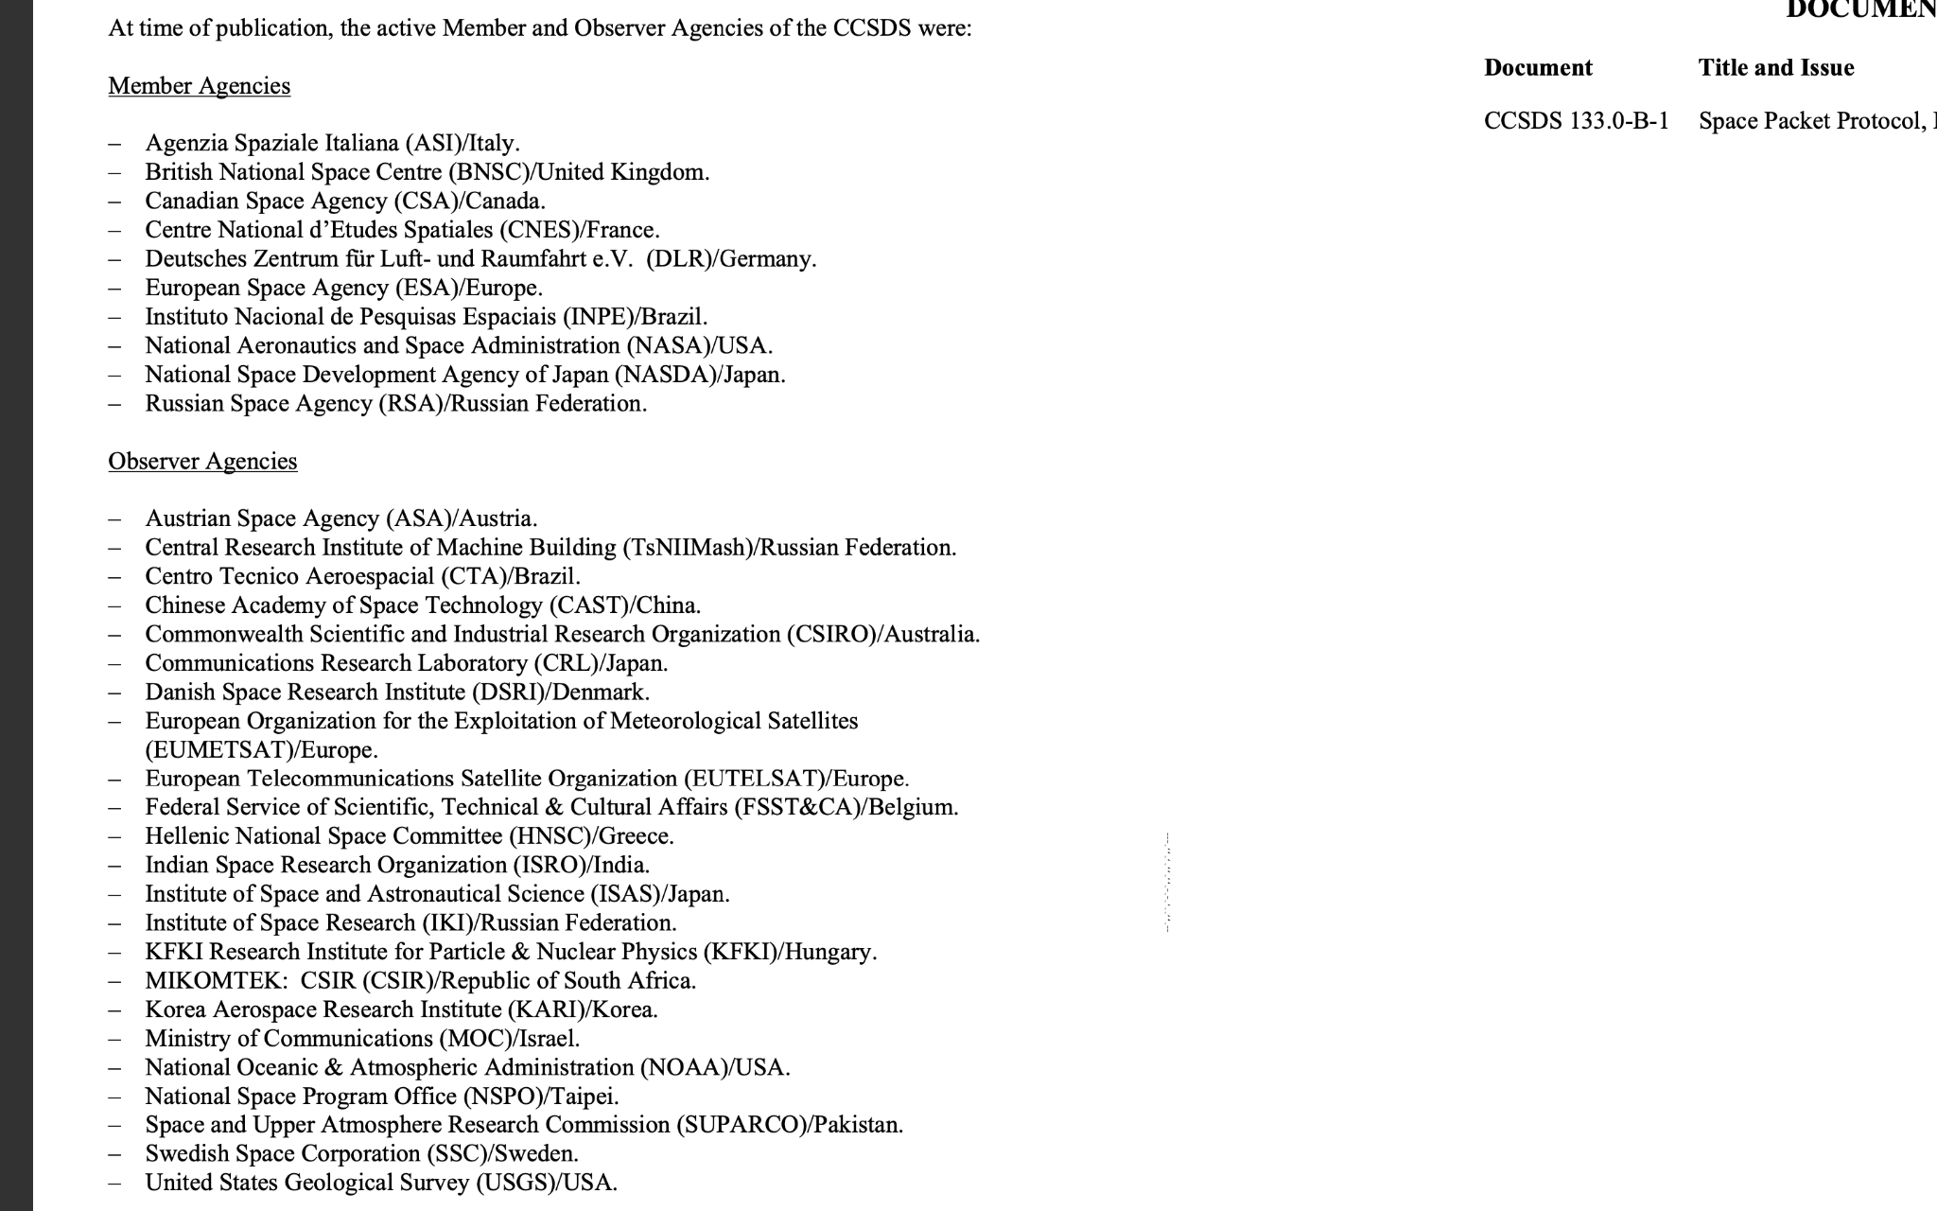
Product/Market Segment
CCSDS (Consultative Committee for Space Data Systems) Agencies
Anyone and everyone interested in going to space
Primarily international agencies
Notes:
To which products/markets does it apply?

Slide 16
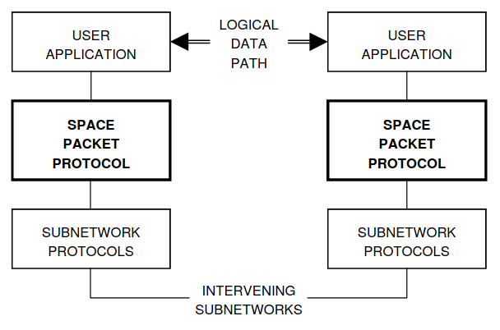
Main Prescriptions: LDP and Management System
LDP (logic data path) defines a unidirectional pathway from source to destination user applications
Each LDP must be configured before data transfer, and assigned a Path ID containing:
APID: Application Process ID
APID Qualifier: domain name containing unique APIDs
LDP configuration handled by high-level management system
Informs intermediate protocol entities where to route packets for a given APID
Set/store long-term parameters

Slide 17
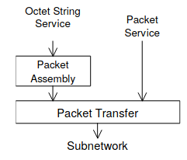
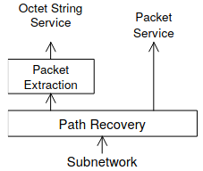
Main Prescriptions: Services and SAPs
User applications interface with Space Packet Protocol at a Service Access Point (SAP)
SAP can be configured to handle pre-formatted space packets (Packet Service) or unformatted octet strings (Octet String Service)
Service primitives:
REQUEST sent from source to SAP to inform service provider that a packet needs to be sent along a given LDP
INDICATION sent from SAP to destination to inform user application of an incoming packet
No guarantee of completeness, confirmation receipt, retransmission, etc
Other characteristics
Pre-configured
Unidirectional
Asynchronous
Non-sequence preserving

Slide 18
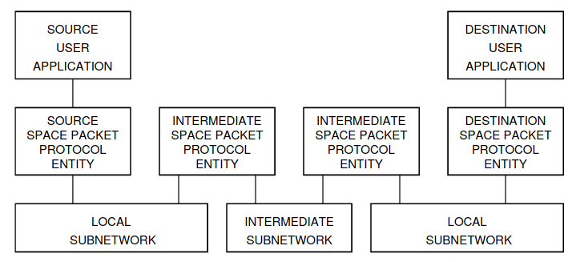
Main Prescriptions: Protocol Entities
Several protocol entities along an LDP
At source and destination:
Implement SAPs and provide services to user applications
At intermediate locations:
Responsible for identifying next subnet in LDP and relaying given space packet
Routing of packets from entity to entity handled by underlying subnetwork protocols

Slide 19
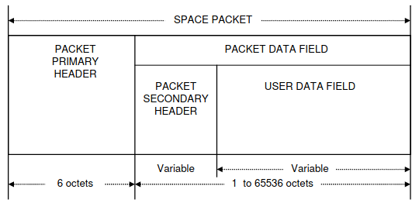
Main Prescriptions: Space Packets
Space packets: data units employed by space packet protocol
Primary header
APID, packet length, sequence count, etc.
Secondary header
Optional ancillary info i.e. time, spacecraft location
User data field
Application-specific
Notes:
What are its main prescriptions?

Slide 20
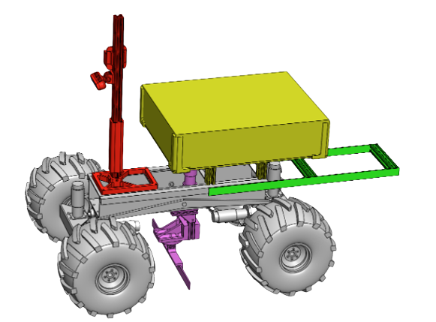
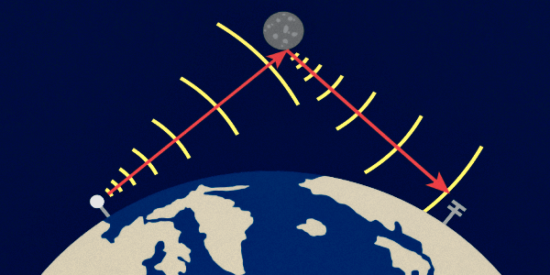
CraterGrader Application
In flight application use case, when communicating between users on earth and CraterGrader:
The logical data path will be pre-configured
Sent packets will abide by the space packet protocol
One standard protocol improves ease of adoption for customers
Need to understand:
Types of services available
How to configure the management system
Dependent on the specific mission and subnetwork
Notes:
How does it apply to the team's project?

Slide 21

CraterGrader Application
Importantly, as flight operations scale → increased # of robots working on the moon
Multi-robot operation → space-to-space communications link
Isolate unique groups of robot operation
Subnetwork establishment and selection to build up the communications pipeline:
Packet header (APID) misidentification likelihood
Space packet loss likelihood
Both need to be under mission-defined thresholds
Notes:
How does it apply to the team's project?

Slide 22

Thank you! Any Questions?

